Slide 1
Histopathology interpretation strategies
Method | Description | FDA Opinion
Single reader | One central reader for all biopsies | Inadequate (Intercept 2020 CRL)
Two-reader consensus – WAYFIND Current Approach | Two pathologists looking at slide/image at the same time to reach a consensus and generated one biopsy report | Unknown
Two-independent-reader adjudication with discordance-triggered third-pathologist arbitration | "At least two experienced pathologists should participate in interpreting the histology slides and one additional pathologist for arbitration should a discrepancy occur" | ATLAS EOP2 Meeting Feedback (GDT 2nd Choice Approach)
Three-independent-reader adjudication with discordance-triggered consensus call | Three independent reads: if 2 agree → final score; if none agree → consensus review | Adequate (Intercept 2023 AdCom) (GDT Recommended Approach)
Two-independent-reader adjudication | Two independent reads, "combined statistically" to generate a single treatment effect | Unknown (Madrigal ITT)
Two-independent-reader adjudication with discordance-triggered consensus call | Two independent reads, disagreement on endpoint led to a consensus read | Unknown (Madrigal repeat analysis mandated by FDA)

Slide 2
FDA favors 3-independent-reader-adjudicated reading strategy
WAYFIND study initially designed with two-reader concurrent consensus reading of all slides – one biopsy report is generated per subject per timepoint
Per the current pathology charter, all baseline slides are going to be re-read with the week 72 slides in blinded and unpaired fashion for efficacy analysis (to minimize impact of reader diagnostic drift over time), therefore we have an opportunity to change the read methodology without disrupting efficacy read timelines
FDA has communicated to multiple sponsors their preference for a three-independent-reader-adjudicated reading strategy (ATLAS EOP2, Intercept CRL, Madrigal)
Deploying three-independent-reader-adjudicated reading strategy in WAYFIND will serve as operational test-run for Phase 3 and generate a helpful comparator dataset for reading methodology ahead of Phase 3 initiation (against baseline Consensus read that has already been conducted)
Changing the biopsy interpretation methodology impacts ancillary documentation (Pathology Charter) but does not constitute a protocol modification

Slide 3
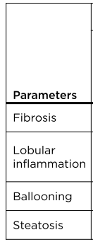
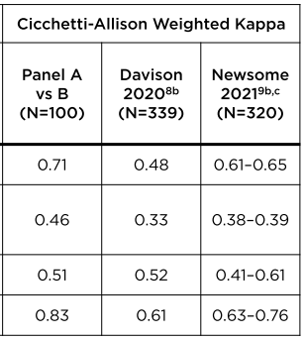
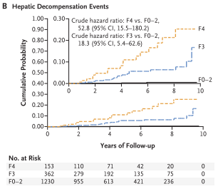
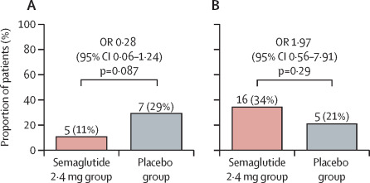
NASH Resolution: Less reliable, less clinically relevant, less likely to be achieved
Key NASH features demonstrate inadequate reproducibility even with panel consensus reading
Fibrosis stage, not NASH features, is strongest prognostic biomarker for clinical events
Semaglutide monotherapy had lower than projected treatment effect on NASH resolution in cirrhosis
Fibrosis Improvement
NASH Resolution
Loomba, R., et al. (2023). The Lancet Gastroenterology & Hepatology.
Sanyal et al. 2021 AASLD Meeting
Sanyal, A. J., et al. (2021). New England Journal of Medicine 385(17): 1559-1569.

Slide 4
Hypothesis Testing Strategies to Answer Key Questions
Current WAYFIND design: co-primary
Proposed design: single primary
PE1: Fibrosis improvement triple vs placebo
PE2: NASH resolution triple vs placebo
SE1: NASH resolution triple vs CILO/FIR
SE2: Fibrosis improvement triple vs SEMA
PE: Fibrosis improvement triple vs placebo
SE1: Fibrosis improvement triple vs SEMA
SE2: NASH resolution triple vs placebo
SE3: NASH resolution triple vs CILO/FIR
Meet both PE1 and PE2: 1-sided P < 0.025 for each
Meet PE: 1-sided P < 0.025
Meet SE1:
1-sided P < 0.025
Meet SE1:
1-sided P < 0.025
Meet SE2:
1-sided P < 0.025
Meet SE2:
1-sided P < 0.025
Meet SE3:
1-sided P < 0.025

Slide 5
Supporting Slides: Futility Analysis
Pre-Read

Slide 6
Futility Analysis: Methodology
Pre-Read
Using empirical conditional power (ECP) approach to set up futility
ECP evaluates the likelihood of success of the study given data observed at IA
Assuming the trend observed at interim stays to the end of the study
Ideal futility criteria would lead to
Low stopping prob when there is a true treatment effect
High stopping prob there is no treatment effect
Small power loss due to futility stopping
Futility IA consideration
Total sample size 450 as of July 14, 2023
205 (123:82) on triple vs placebo
Sample size at IA: N = 82 and 102 (corresponding to 40% and 50% information) on triple vs placebo
Criteria for futility: ECP < 0.05, 0.1 or 0.15

Slide 7
Futility IA assessment – Fibrosis Improvement (Triple vs Placebo) 15% Dropout Rate
Pre-Read
Futility Criteria per IA ECP¹ | True Tx Effect² | Study Power³ | Prob of Stopping due to Futility |  | Power Loss
 |  |  | N = 49:33 (40%) | N = 61:41 (50%) | N = 49:33 (40%) | N = 61:41 (50%)
ECP ≤ 5% | 0% | 2.3% | 68.2% | 72.2% | 0.2% | 0.1%
 | 15% | 63.0% | 14.3% | 14.0% | 2.9% | 2.0%
 | 20% | 84.7% | 6.7% | 5.8% | 2.6% | 1.7%
 | 23% | 92.3% | 4.0% | 3.2% | 2.1% | 1.3%
ECP ≤ 10% | 0% | 2.3% | 71.7% | 78.1% | 0.3% | 0.2%
 | 15% | 63.0% | 19.3% | 18.1% | 4.7% | 3.2%
 | 20% | 84.7% | 9.5% | 8.1% | 4.3% | 2.8%
 | 23% | 92.3% | 5.9% | 4.7% | 3.4% | 2.2%
ECP ≤ 15% | 0% | 2.3% | 77.2% | 79.3% | 0.4% | 0.3%
 | 15% | 63.0% | 21.7% | 21.7% | 5.6% | 4.5%
 | 20% | 84.7% | 11.2% | 10.2% | 5.3% | 4.0%
 | 23% | 92.3% | 7.1% | 6.0% | 4.3% | 3.1%
¹ Based on Pearson’s Chi-square test with 1-sided significant level of 0.025
² Placebo corrected; assume 12% PBO response
³ Study power before futility analysis is incorporated. ~205 (123:82) subjects at the final analysis; 15% dropout; missing data imputed with RBI

Slide 8
Futility IA assessment – Fibrosis Improvement (Triple vs Placebo) 18% Dropout Rate
Pre-Read
Futility Criteria per IA ECP¹ | True Tx Effect² | Study Power³ | Prob of Stopping due to Futility |  | Power Loss
 |  |  | N = 49:33 (40%) | N = 61:41 (50%) | N = 49:33 (40%) | N = 61:41 (50%)
ECP ≤ 5% | 0% | 2.3% | 68.2% | 72.2% | 0.2% | 0.1%
 | 15% | 60.2% | 15.4% | 15.2% | 2.9% | 2.0%
 | 20% | 82.3% | 7.5% | 6.6% | 2.7% | 1.8%
 | 23% | 90.6% | 4.6% | 3.7% | 2.3% | 1.4%
ECP ≤ 10% | 0% | 2.3% | 71.7% | 78.1% | 0.3% | 0.2%
 | 15% | 60.2% | 20.6% | 19.5% | 4.6% | 3.2%
 | 20% | 82.3% | 10.6% | 9.2% | 4.4% | 3.0%
 | 23% | 90.6% | 6.7% | 5.5% | 3.6% | 2.4%
ECP ≤ 15% | 0% | 2.3% | 77.2% | 79.3% | 0.4% | 0.3%
 | 15% | 60.2% | 23.1% | 23.2% | 5.5% | 4.5%
 | 20% | 82.3% | 12.4% | 11.5% | 5.4% | 4.2%
 | 23% | 90.6% | 8.1% | 7.0% | 4.6% | 3.4%
¹ Based on Pearson’s Chi-square test with 1-sided significant level of 0.025
² Placebo corrected; assume 12% PBO response
³ Study power before futility analysis is incorporated. ~205 (123:82) subjects at the final analysis; 18% dropout; missing data imputed with RBI

Slide 9
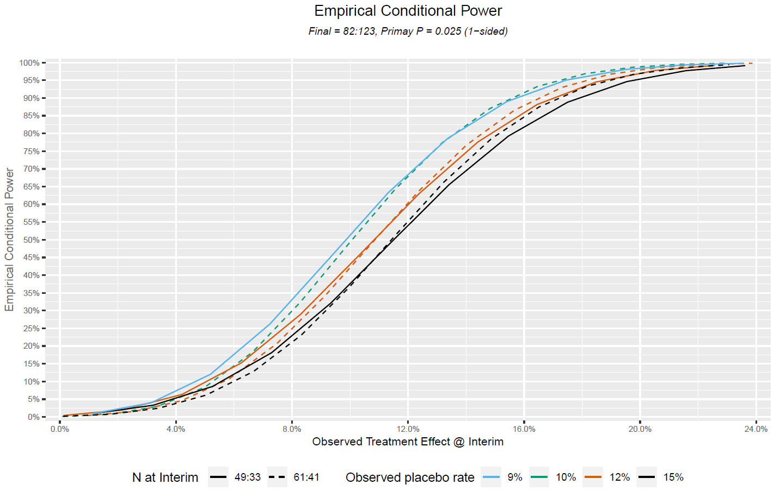
Pre-Read

Slide 10
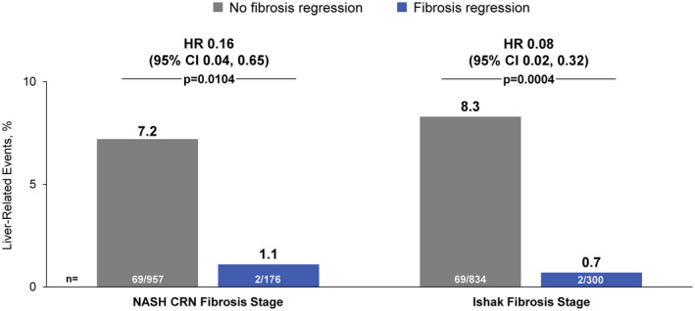
Fibrosis Improvement Associated with Outcomes
Pre-Read
Association between fibrosis regression and liver‐related clinical events in NASH cirrhosis. HR for clinical events with fibrosis regression vs. no fibrosis regression (reference). p values by Fisher’s exact test
Sanyal, Arun J et al. “Cirrhosis regression is associated with improved clinical outcomes in patients with nonalcoholic steatohepatitis.” Hepatology (Baltimore, Md.) vol. 75,5 (2022): 1235-1246. doi:10.1002/hep.32204

Slide 11

Hypothesis Testing Strategy for Alternative Endpoint
Pre-Read
For Dual primary endpoints for fibrosis improvement OR NASH resolution, we would employ a graphical testing procedure
Converting from a co-primary to dual primary endpoints will increase overall study power in WAYFIND
$$α$$
0
0.5
PE1
PE2
0.9998
PE1: Fibrosis improvement triple vs placebo
PE2: NASH resolution triple vs placebo
SE1: Fibrosis improvement triple vs SEMA
SE2: NASH resolution triple vs FDC
0.5
0.0002
0.9998
0.0002
SE1
SE2
0
0

Slide 12




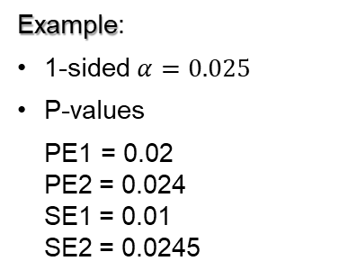


How Graphical Testing Procedure Works
Pre-Read
Graphical testing procedure:
$$α$$
0
$$0.5×α$$
$$0.9999×α$$
0.5
Example:
1-sided $α=0.025$
P-values
PE1 = 0.02 PE2 = 0.024 SE1 = 0.01 SE2 = 0.0245
PE1
PE2
PE2
PE2
0.5
0.9998
0.0002
0.9998
0.0002
1
0.9998
0.9998
0.0002
0.0002
SE1
SE2
SE1
SE2
SE2
0
0
$$0.5×α$$
0
0.0001$×α$
PE1: Fibrosis improvement triple vs placebo
PE2: NASH resolution triple vs placebo
SE1: Fibrosis improvement triple vs SEMA
SE2: NASH resolution triple vs FDC
$$0.5×α$$

